Slide 1
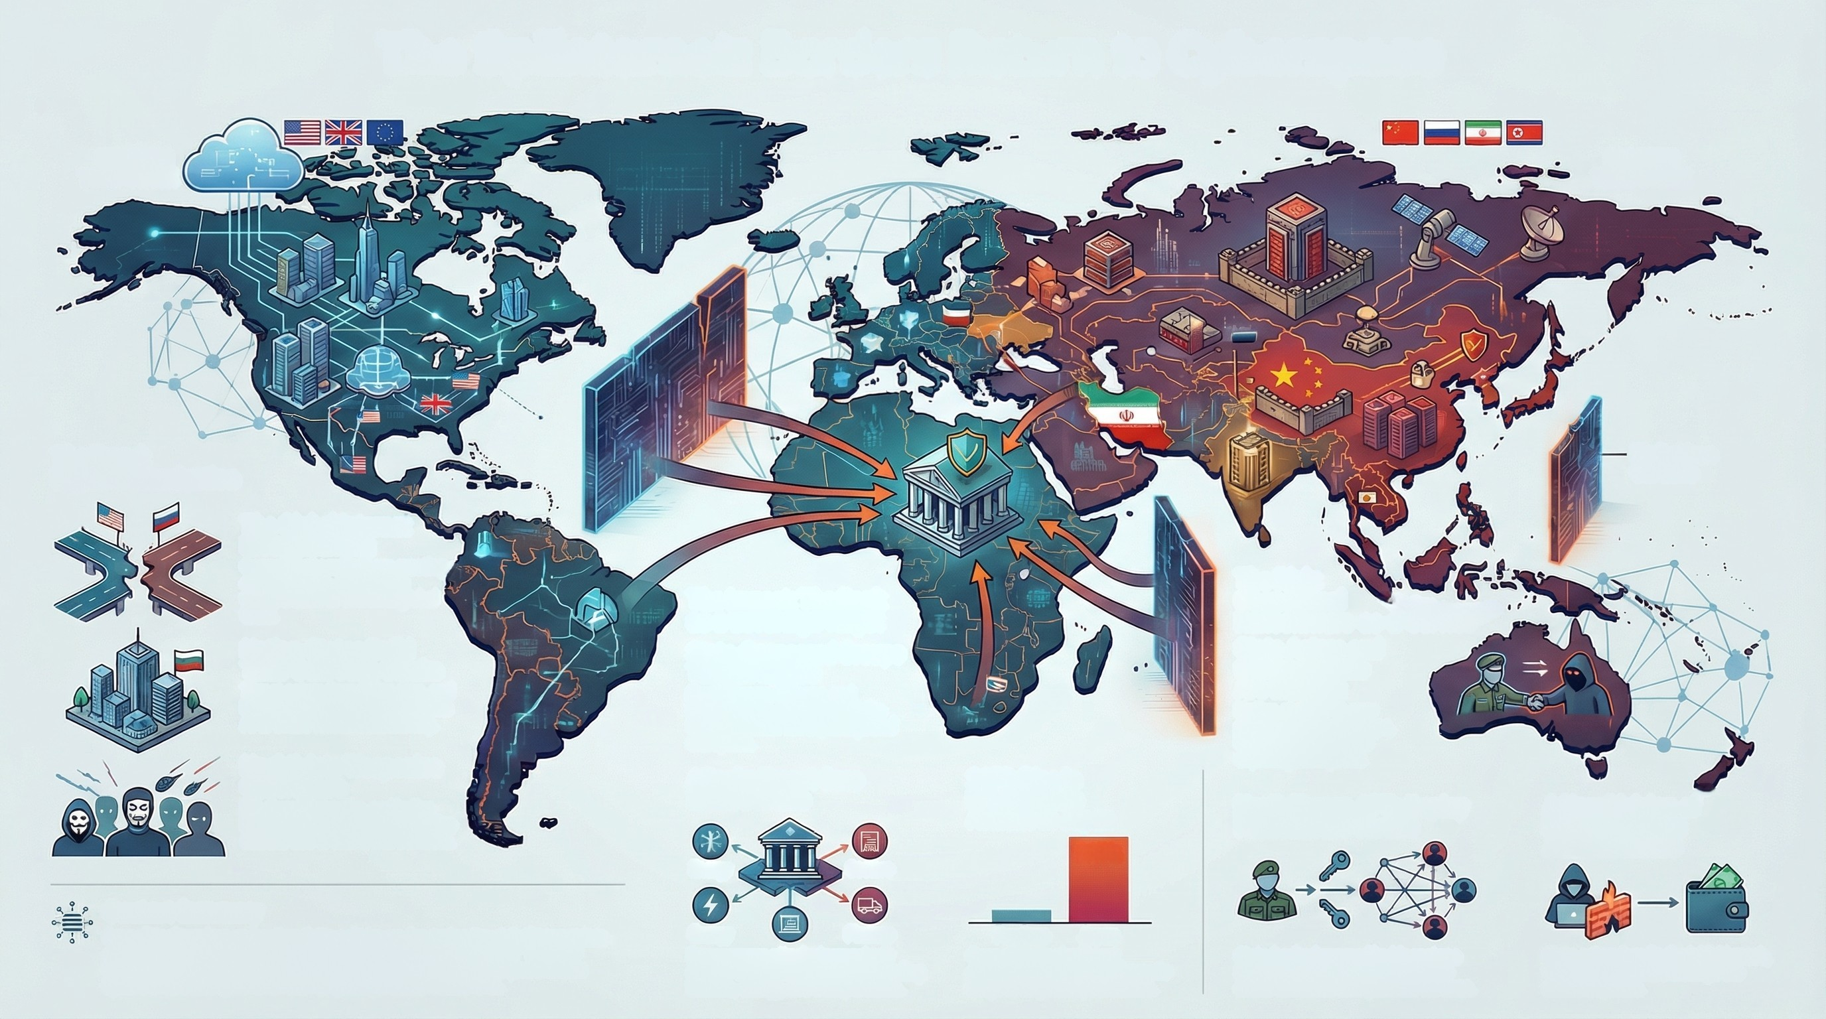
The Splinternet: Borders Return to Cyberspace
WESTERN
TECH STACK
EASTERN
TECH STACK
The Trend:
Digital Balkanization
>
Digital Iron
Curtains
The Global Internet
is Fragmenting
Geopolitical confliets are creating
digital borders, challenging
the operation of common global
tools.
The Impact: The Bank
as a Sovereign Target
State-Sponsored Groups
Target Finance
North Korean, Chinese, and
Russian APTS actively target the
financial sector for explonage and
disruption.
The Risk:
Geopolitical
Ransomware-as-a-Service
State Actors and
Cybercriminals
Are Merging
Nation-state APTs now
partner with ftead groups,
blurring lines between
explonage and profit.
Nation-States Build
Their Own Tech Stacks
Threat actors from China, Iran, and
Russia are developing homegrown
Al to avade Western monitoring.
Hacktivists Weaponize
Cyberspace
Pro-Russian, Iranian, and indian
hacktivist groups launch diangitive
attacks tied to real-world conflicts.
Attacks Target Core
Infrastructure
217% Rise in
Ransomware
Attacks in Japan
North Korean APTS Deploy
Ransomware Cartels
A New Division of
Labor Increases
Attack Success
Sectors
217%
Energy
Context Summary
Finance
Previous
Geopolitical tensions and nationalistic policies are fracturing the global internet into
competing "Digital Bloss," s phenomonop known as the "Eplintemes" This new
landscape blurs the lines between stats-sponsored expinnage and profit-driven
cybercrime, creating novel threats for global financial institutions.
Energy
Rensomware attacks increasingly
disrupt critical infrastructure, including
finance, energy, and transportation.
Japan
Geopolitically significant
economes are seeing a dramatic
surge in targeted cyberattacks.
Stats-backed groups like Moonstone
Sleet now distribute ransomware to
evade sanctions and generate revenue.
Stats sctors handle the initial breach,
while RaaS affiliates manage the
extortion phase.

